Slide 1


Period End Closing Execution (BSC)
Period End Closing Overview
Period End Closing Key Process Areas and New Period End Checks
Post Closing Activities
Year End Specific Closing Activities

Slide 2
Period End Closing Execution (GBS/JTBC)
Reversal of Documents with a Specified Reversal Date (F.81)
Post Closing Activities
Update Period Control Related Locks

Slide 3
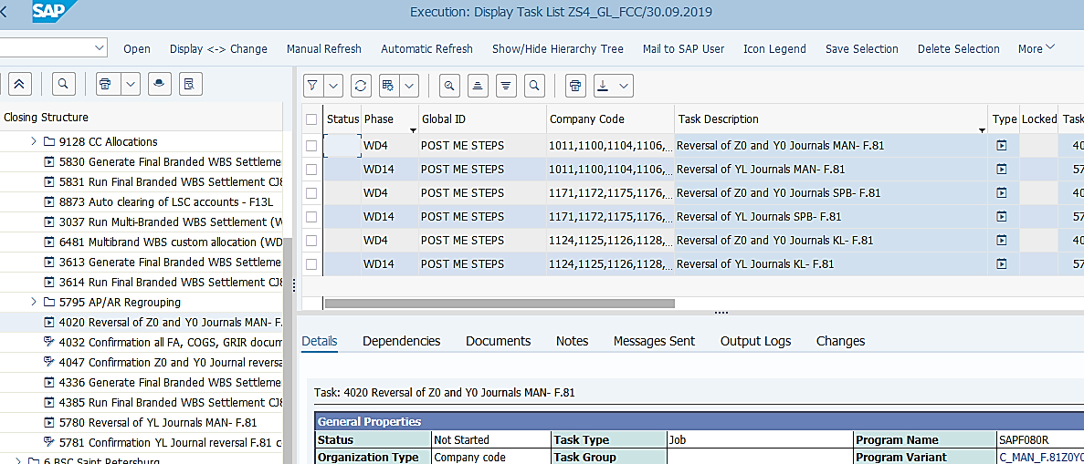
Reversal of Documents with a Specified Reversal Date (F.81)
Basic Process of F.81
Documents posted in current period with future Reversal Date
Reversal of these documents in new period
During the month entities submit MyRequest templates to post documents.
Some of these documents have a Reversal Date specified on the document header. These are normally a date in the following period.
These documents can be posted to any of the core ledger(s), which include document types Z0, Y0 and YL.
When period end closing activities are all completed after WD3, GBS/JTBC will execute T-Code F.81 to mass reverse all the documents which have a reversal date of the new period.
This is done for the 3 document types (Z0, Y0 and YL), on different WDs for IFRS closing and STAT/TAX closing respectively.
The variants used in F.81 are GBS/JTBC variants therefore should use Company Code variable. They also use dates/periods/years variables. You should always check/amend the values of Company Code and dates/periods/years fields to ensure they are correct before executing the transaction outside of FCC.
T-Code: F.81
F.81 functionality remains the same in S/4 HANA as compared to ECC. In S/4 HANA, because of the introduction of Parallel Ledger, the document types have changed, as a result, the document types requiring mass reversal via F.81 have also changed. It now includes document types Z0 and Y0 impacting IFRS ledger and YL impacting STAT/TAX ledger(s).
FCC Task: GBS/JTBC Level
The F.81 task is set at GBS/JTBC level for all entities within a given GBS/JTBC that have such documents.
Timing:
WD4 – IFRS, WD14 – STAT/TAX
The same transaction is used to perform reversal for both IFRS ledger closing and STAT/TAX ledger closing.

Slide 4
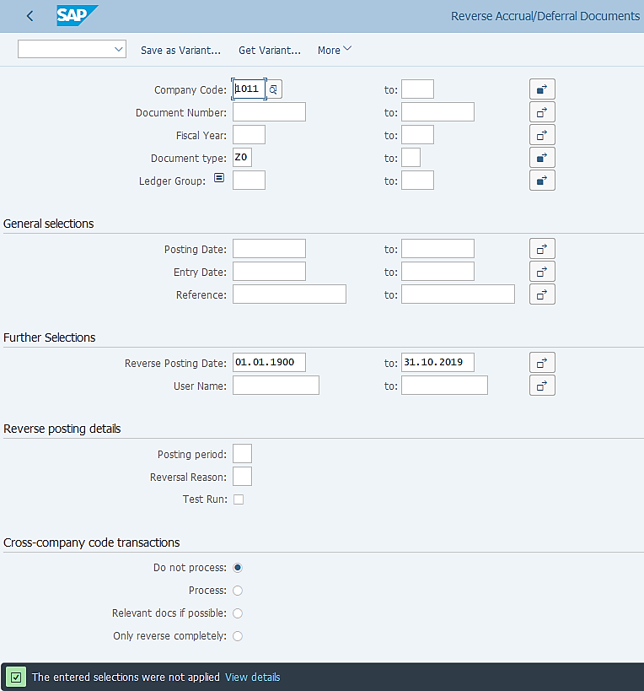

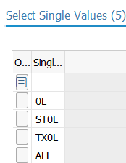
Reversal of Documents with a Specified Reversal Date (F.81): Execution
F.81: Reverse Accrual/Deferral Documents
In the variants used by each GBS/JTBC, the company codes which use such documents are selected. This of course needs to be updated when you have new entities joining.
In this example we have Document Type Z0 and Y0, as this is a variant for IFRS closing. In the variant for STAT/TAX closing you will see Document Type YL included.
Again as this is for IFRS, you can see the document types we selected, Z0 and Y0, which could be posted to these four ledger groups: Blank & ALL – for All ledgers, 0L – for IFRS only, ST0L – for STAT and IFRS, and TX0L - for TAX and IFRS.
In the variant for STAT/TAX, the Ledger group selected are: ST – STAT only, TX – TAX only and STTX – for STAT and TAX ledgers.
You can simply select the one month period which is currently open, i.e. in this case from 01.10.2019 to 31.10.2019. However this date comes from a variable specified in FCC task list, which will automatically recognize the period which we are closing, from which it determines the date for reversal postings. You should not try to change it unless the automatically determined date is incorrect for the purpose of your execution outside of FCC.
Test Run is not selected in the variants however if you are to execute it outside of FCC, it is recommended that you run Test Run first then Update Run, as there might be errors you may want to fix before doing an Update Run.

Slide 5
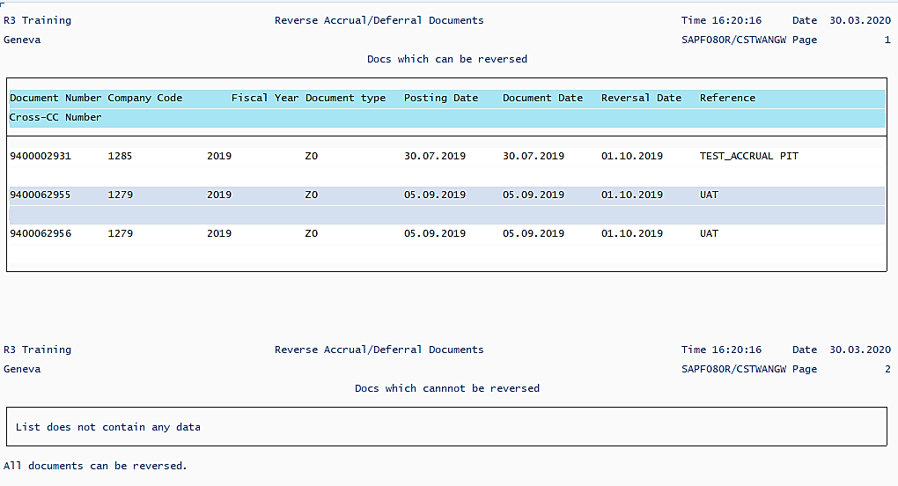
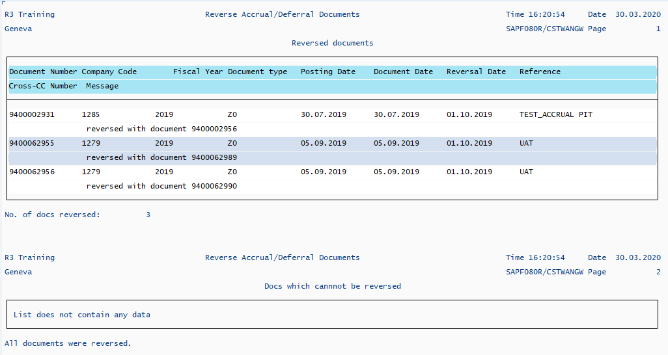
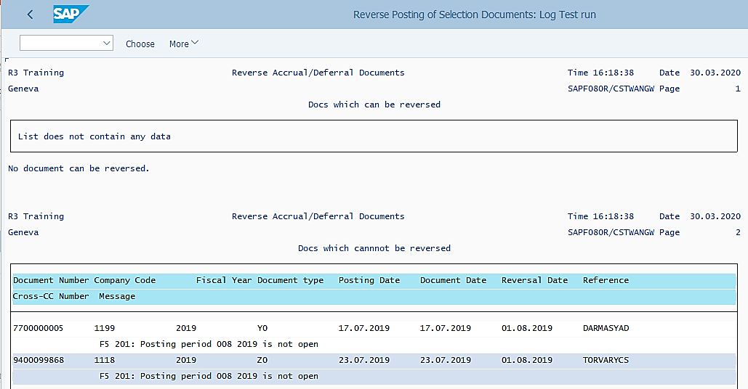
Reversal of Documents with a Specified Reversal Date (F.81): Output
F.81: Reverse Accrual/Deferral Documents
– Test Run Output when documents can be reversed
F.81: Reverse Accrual/Deferral Documents
– Update Run Output when documents can be reversed
F.81: Reverse Accrual/Deferral Documents
– Test Run Output when documents cannot be reversed
The output will show you which documents can be reversed and which cannot, and if not what the reason is.
In an update run where some documents can be reversed, the output will provide you with the reversal document numbers.

Slide 6
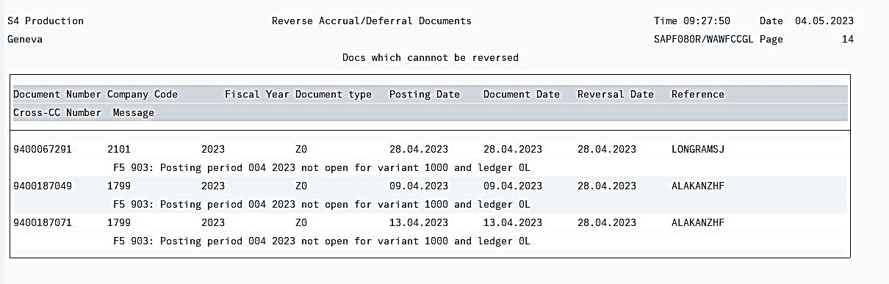
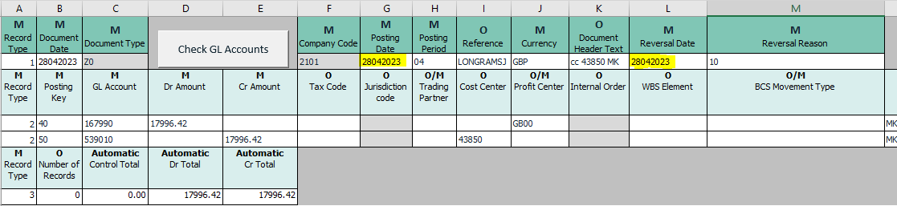
Reversal of Documents with a Specified Reversal Date (F.81):Common Errors
Detail of the “Errors” can be checked from the “Output Logs”. GL Team needs to check the error and work as per the resolution mentioned below.
Errors | Error Description (Reason) | Resolution
Posting period XX 20XX not open for variant 1000 and ledger 0L | This error occurs when the Reversal Date entered in Journal Posting Template is in the same period as posting date or in already closed period. | GL Team needs to contact Requestor, explain that the indicated reversal date is in the closed period. Ask requestor to initiate MR request GL04 template for correction of reversal date.

Slide 7
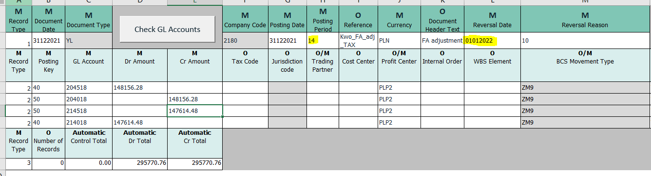
Reversal of Documents with a Specified Reversal Date (F.81):Common Errors
Errors | Error Description (Reason) | Resolution
Posting period 001 20XX not open for variant 3000 and ledger TX/ST | This error occurs when For posting done in period 14 the correct reversal date is not in January. It should be the next period after the one the document was entered to the system. Posting date: 31.12.2021 Posting period: 14 Entry date: 27.01.2022 Reversal Date: 01.02.2022 | Contact requestor, explain that the indicated reversal date is incorrect. Ask requestor to initiate MR request GL04 template for correction of reversal date.

Slide 8
Reversal of Documents with a Specified Reversal Date (F.81):Common Errors
Errors | Error Description (Reason) | Resolution
Item XXX WBS XXXXXXX budget exceeded | This error occurs when budget for WBS becomes exceeded. | GL Team needs to request market to increase budget for WBS. Re-execute the transaction with T-code F.81 (for mass reversal) or FB08 (for single reversal)
Cost center XXXXX blocked against direct posting on XX.XX.XXXX | This error occurs when Cost Center is Blocked. | GL Team needs to sk market to unblock cost center. Re-execute the transaction with T-code F.81 (for mass reversal) or FB08 (for single reversal)
GL account XXXXXX is blocked | This error occurs, when GL account is blocked for posting | GL Team needs to ask market to unblock GL account. Re-execute the transaction with T-code F.81 (for mass reversal) or FB08 (for single reversal).
Project XXXXXX is currently being processed by XXXXXX | This error occurs when User from other team entered WBS element details during reversal done by FCC. | GL Team to contact respective user who is currently processing the Project to close this Project in SAP. Post receiving confirmation proceed to re-run FCC task or document need to be reversed manually in the next period.

Slide 9
Period End Closing Execution (GBS/JTBC)
Reversal of Documents with a Specified Reversal Date (F.81)
Post Closing Activities
Update Period Control Related Locks

Slide 10

Update Period Control Related Locks
GBS Warsaw updates “Date of Prior Period Last Posting Date”
Unlock Posting to Asset Accounts
Unlock Posting to G&A/Marketing
Unlock Posting to all GR/IR
GBS Warsaw control to Unlock all COGS
T-Code: ZFFITMONTH_END
T-Code:
ZFFITCOMPANY_AS
T-Code:
ZPERIOD_BLOCK_CD
T-Code:
ZFFITCOMPANY_CD
T-Code:
ZFFITCOMPANY_COGS
FCC Task: Global (Note task in FCC)
FCC Task: JTBC Level (Note task in FCC)
FCC Task: JTBC Level (Note task in FCC)
FCC Task: JTBC Level (Note task in FCC)
FCC Task: GBS Level (Note task in FCC)
Timing: WD4
Timing: WD4
Timing: WD4
Timing: WD4
Timing: WD4
If you remember from the previous chapters, the above dates and blocks have been set in order to stop postings of certain items (Assets, G&A/Marketing, GR/IR) in the period that we are closing, but allow such postings in the new period. Therefore when we have finished closing, we should remove these locks and set the date for the new period, so that when are closing the next period, we can continue to set the lock as we did for the month we just closed.

Slide 11
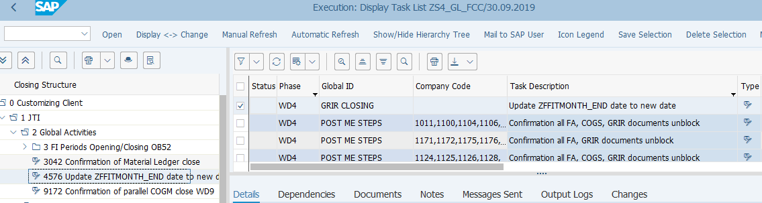
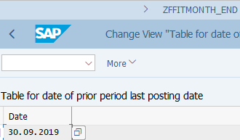
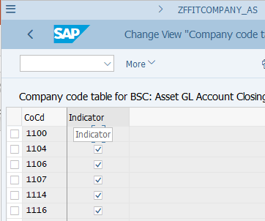
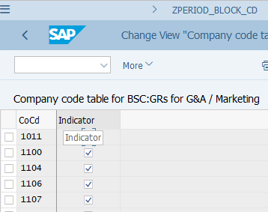
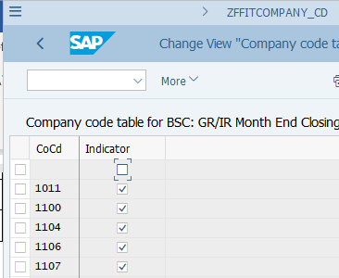
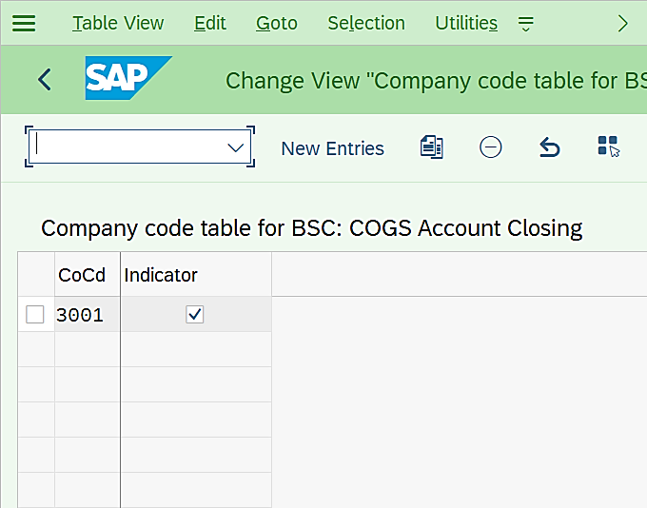
Update Period Control Related Locks
FCLOCO: FCC Task List
Update this date to the last date of the current period (as per system date) to prepare for the next closing.
ZFFITCOMPANY_COGS
Remove the lock indicators in these tables. You should then start ticking them again during the course of the next closing, as we explained in various earlier chapters of this course.

